Slide 1
Conclusion
August 12th, 2020

Slide 2
Wrap-Up Announcements

Slide 3
Announcements
The final is tomorrow from 5 - 8 PM PDT. The exam was emailed.
More exam info is on the course website and Piazza.
All grades except for the final will be shortly on OKPY after the lecture.
See howamidoing to see your progress in the class and what you need on the final to get the grade you want.
If your howamidoing and OKPY disagrees, OKPY is correct
Regrade requests for all assignments are due Friday at 11:59 PM.
We'll work to grade your final as soon as we can and should get grades back to you Sunday or Monday.
Because of campus deadlines for submitting grades, we'll only allow final exam regrades for 24 hours after we release them.
Fill out the Scheme Art Contest Votes + Department Course Evaluation!
If >= 85% of the class fills both surveys out, everyone will receive 1 EC point on the final

Slide 4
Scheme Contest gallery
Notes:
TODO LINK THE GALLARY

Slide 5
What is CS 61A? Revisited

Slide 6
What is CS 61A?
A course about managing complexity
Mastering functional abstraction and data abstraction
Learning trade-offs of various programming paradigms
An introduction to programming
Learning how to write programs in Python, Scheme, and SQL
Combining multiple programming techniques in large projects
Understanding how computers interpret programming languages
A challenging course that demanded a lot of you

Slide 7
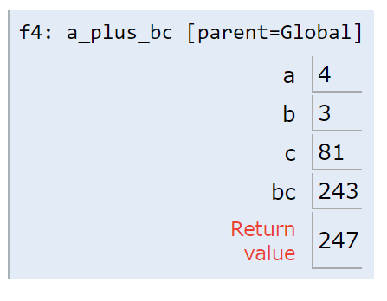
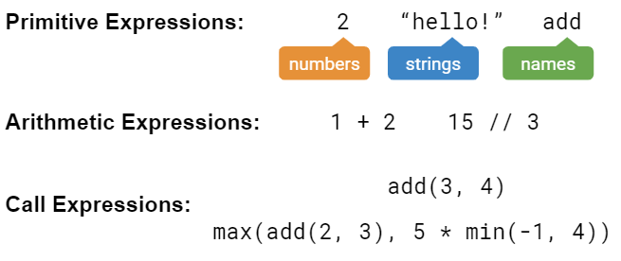
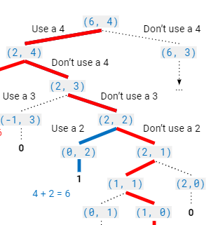
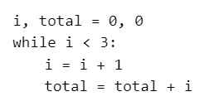
“Building Blocks” of Programs

Slide 8
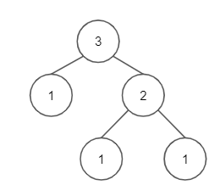
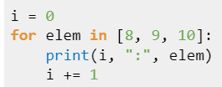
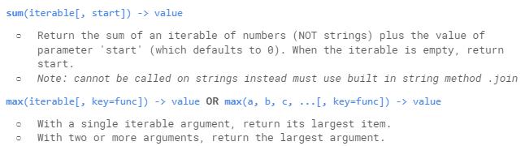
Representing Collections of Data

Slide 9
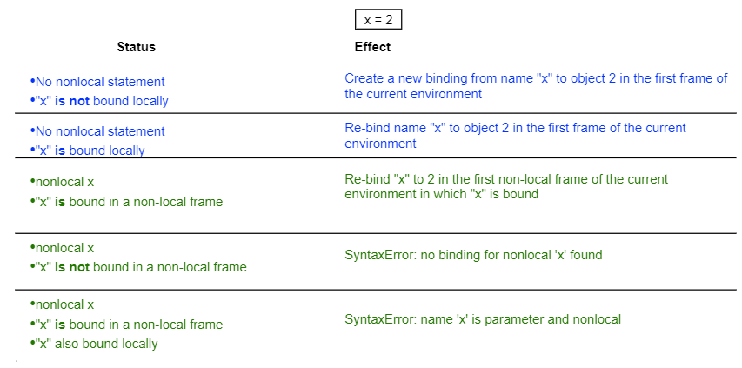

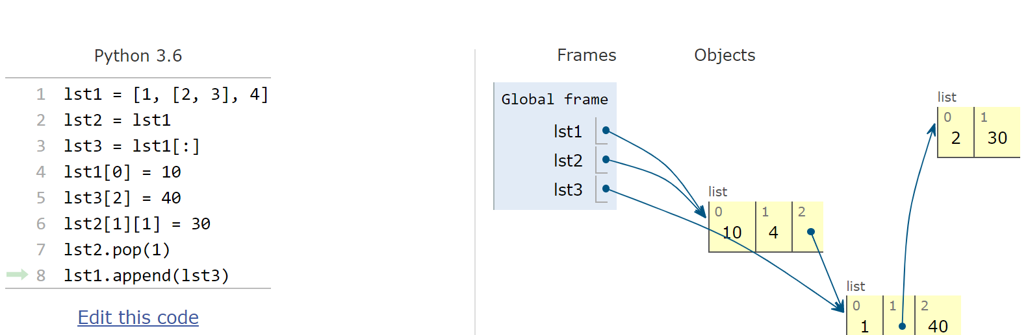
Mutability

Slide 10

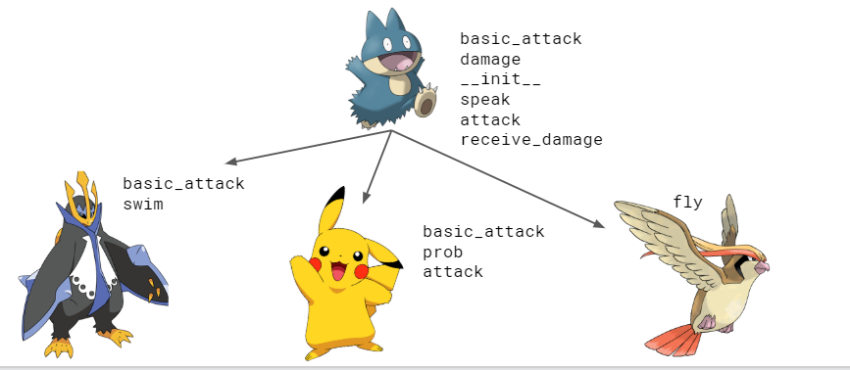
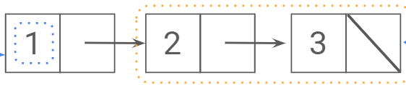
Object-Oriented Programming

Slide 11
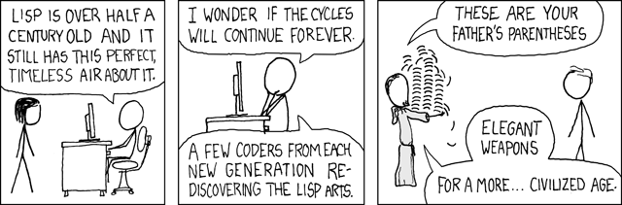
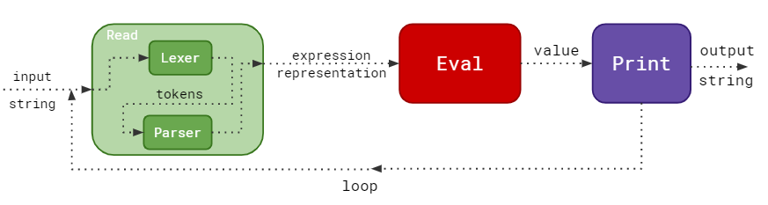
Languages / Interpreters

Slide 12
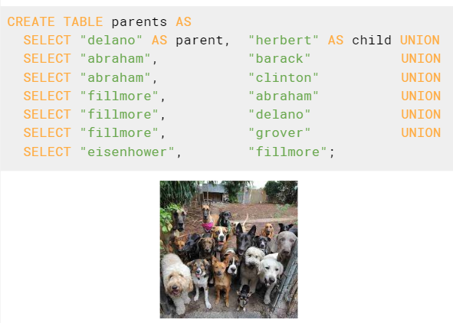
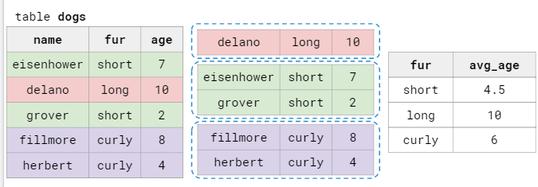
Paradigms & Databases

Slide 13
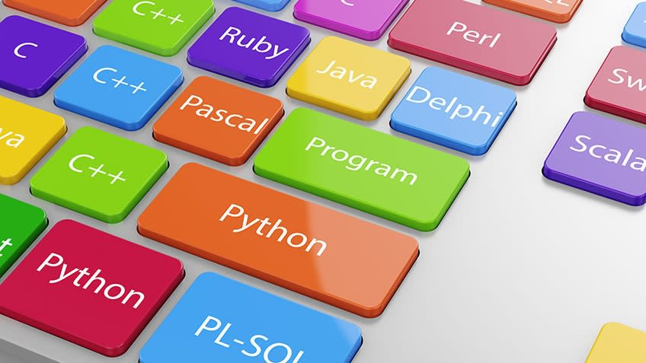

Applications

Slide 14
What's Next?

Slide 15
The 61 Series
61A teaches what programming is - the techniques it involves, and how programs are executed
61B shows you why these techniques are important for programming - you’ll apply them to even larger projects and use them to make your code even more efficient
61C shows you how programs are actually executed and the implications that has for writing code

Slide 16
Other classes
CS 70 - Discrete Mathematics and Probability Theory
Data 8 - Foundations of Data Science
Upper division classes:
CS 170 - Efficient Algorithms and Intractable Problems, requires CS 61B & CS 70
CS 188 - Introduction to Artificial Intelligence, requires CS 61B & CS 70
CS 186 - Introduction to Database Systems, requires CS 61B (and CS 61C)
CS 161 - Computer Security, requires CS 61C and CS 70
And many more!

Slide 17
Teaching
Become a Computer Science Mentor
Lead small-group mentoring sections
Help create the community you want to see
Inspire others to pursue computer science
Learn teaching and one on one tutor through CS 370
3 unit pedagogy course offered during the semester
Learn how to be a good teacher
One on one tutor students
There will be no opportunity for academic interning next semester :(. But look out for the future semesters!

Slide 18
Parting Thoughts

Slide 19
Sleep, eat, get sunlight
Never be afraid to reach out to someone or ask for help
Look for intersections and go an abstraction level below what you are interested in

Slide 20
Coming out of this class, you know how to program
That puts you easily in the top 1% of programming skill among people who are currently alive
You can (maybe even should) take pride in this
But
don’t become an elitist

Slide 21
College is not just about academics.
Take time in college to explore what you really want your life to be about

Slide 22
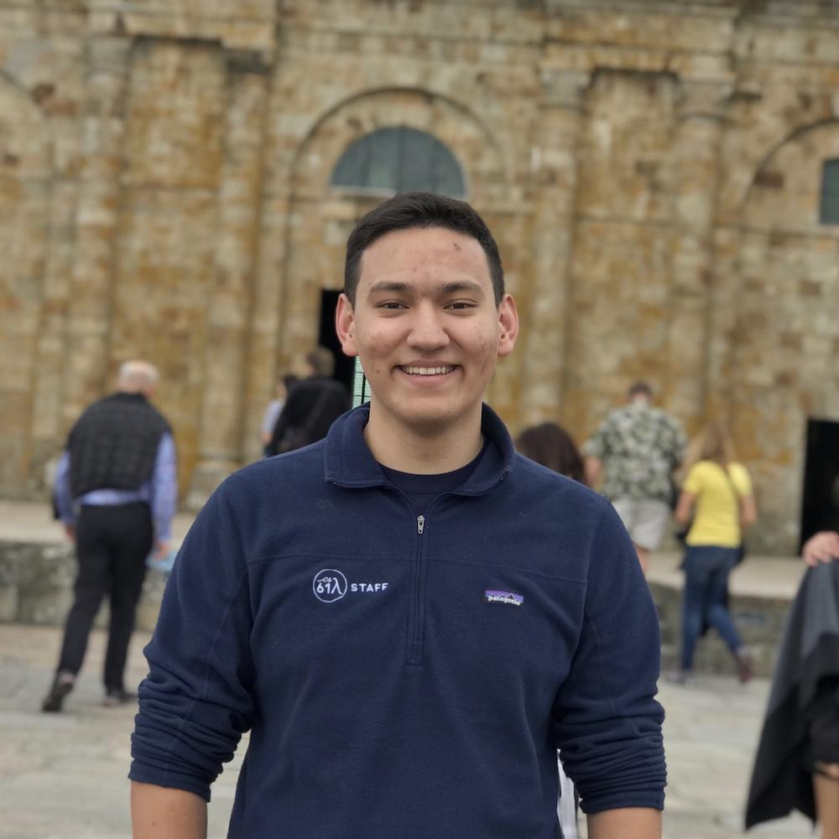

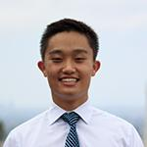
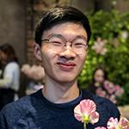

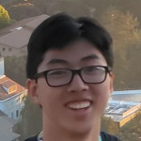

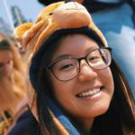


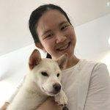

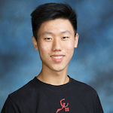
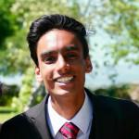
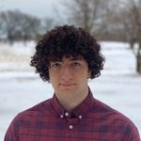
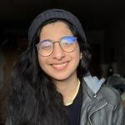
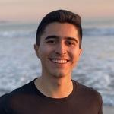
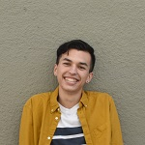
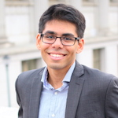
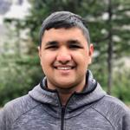
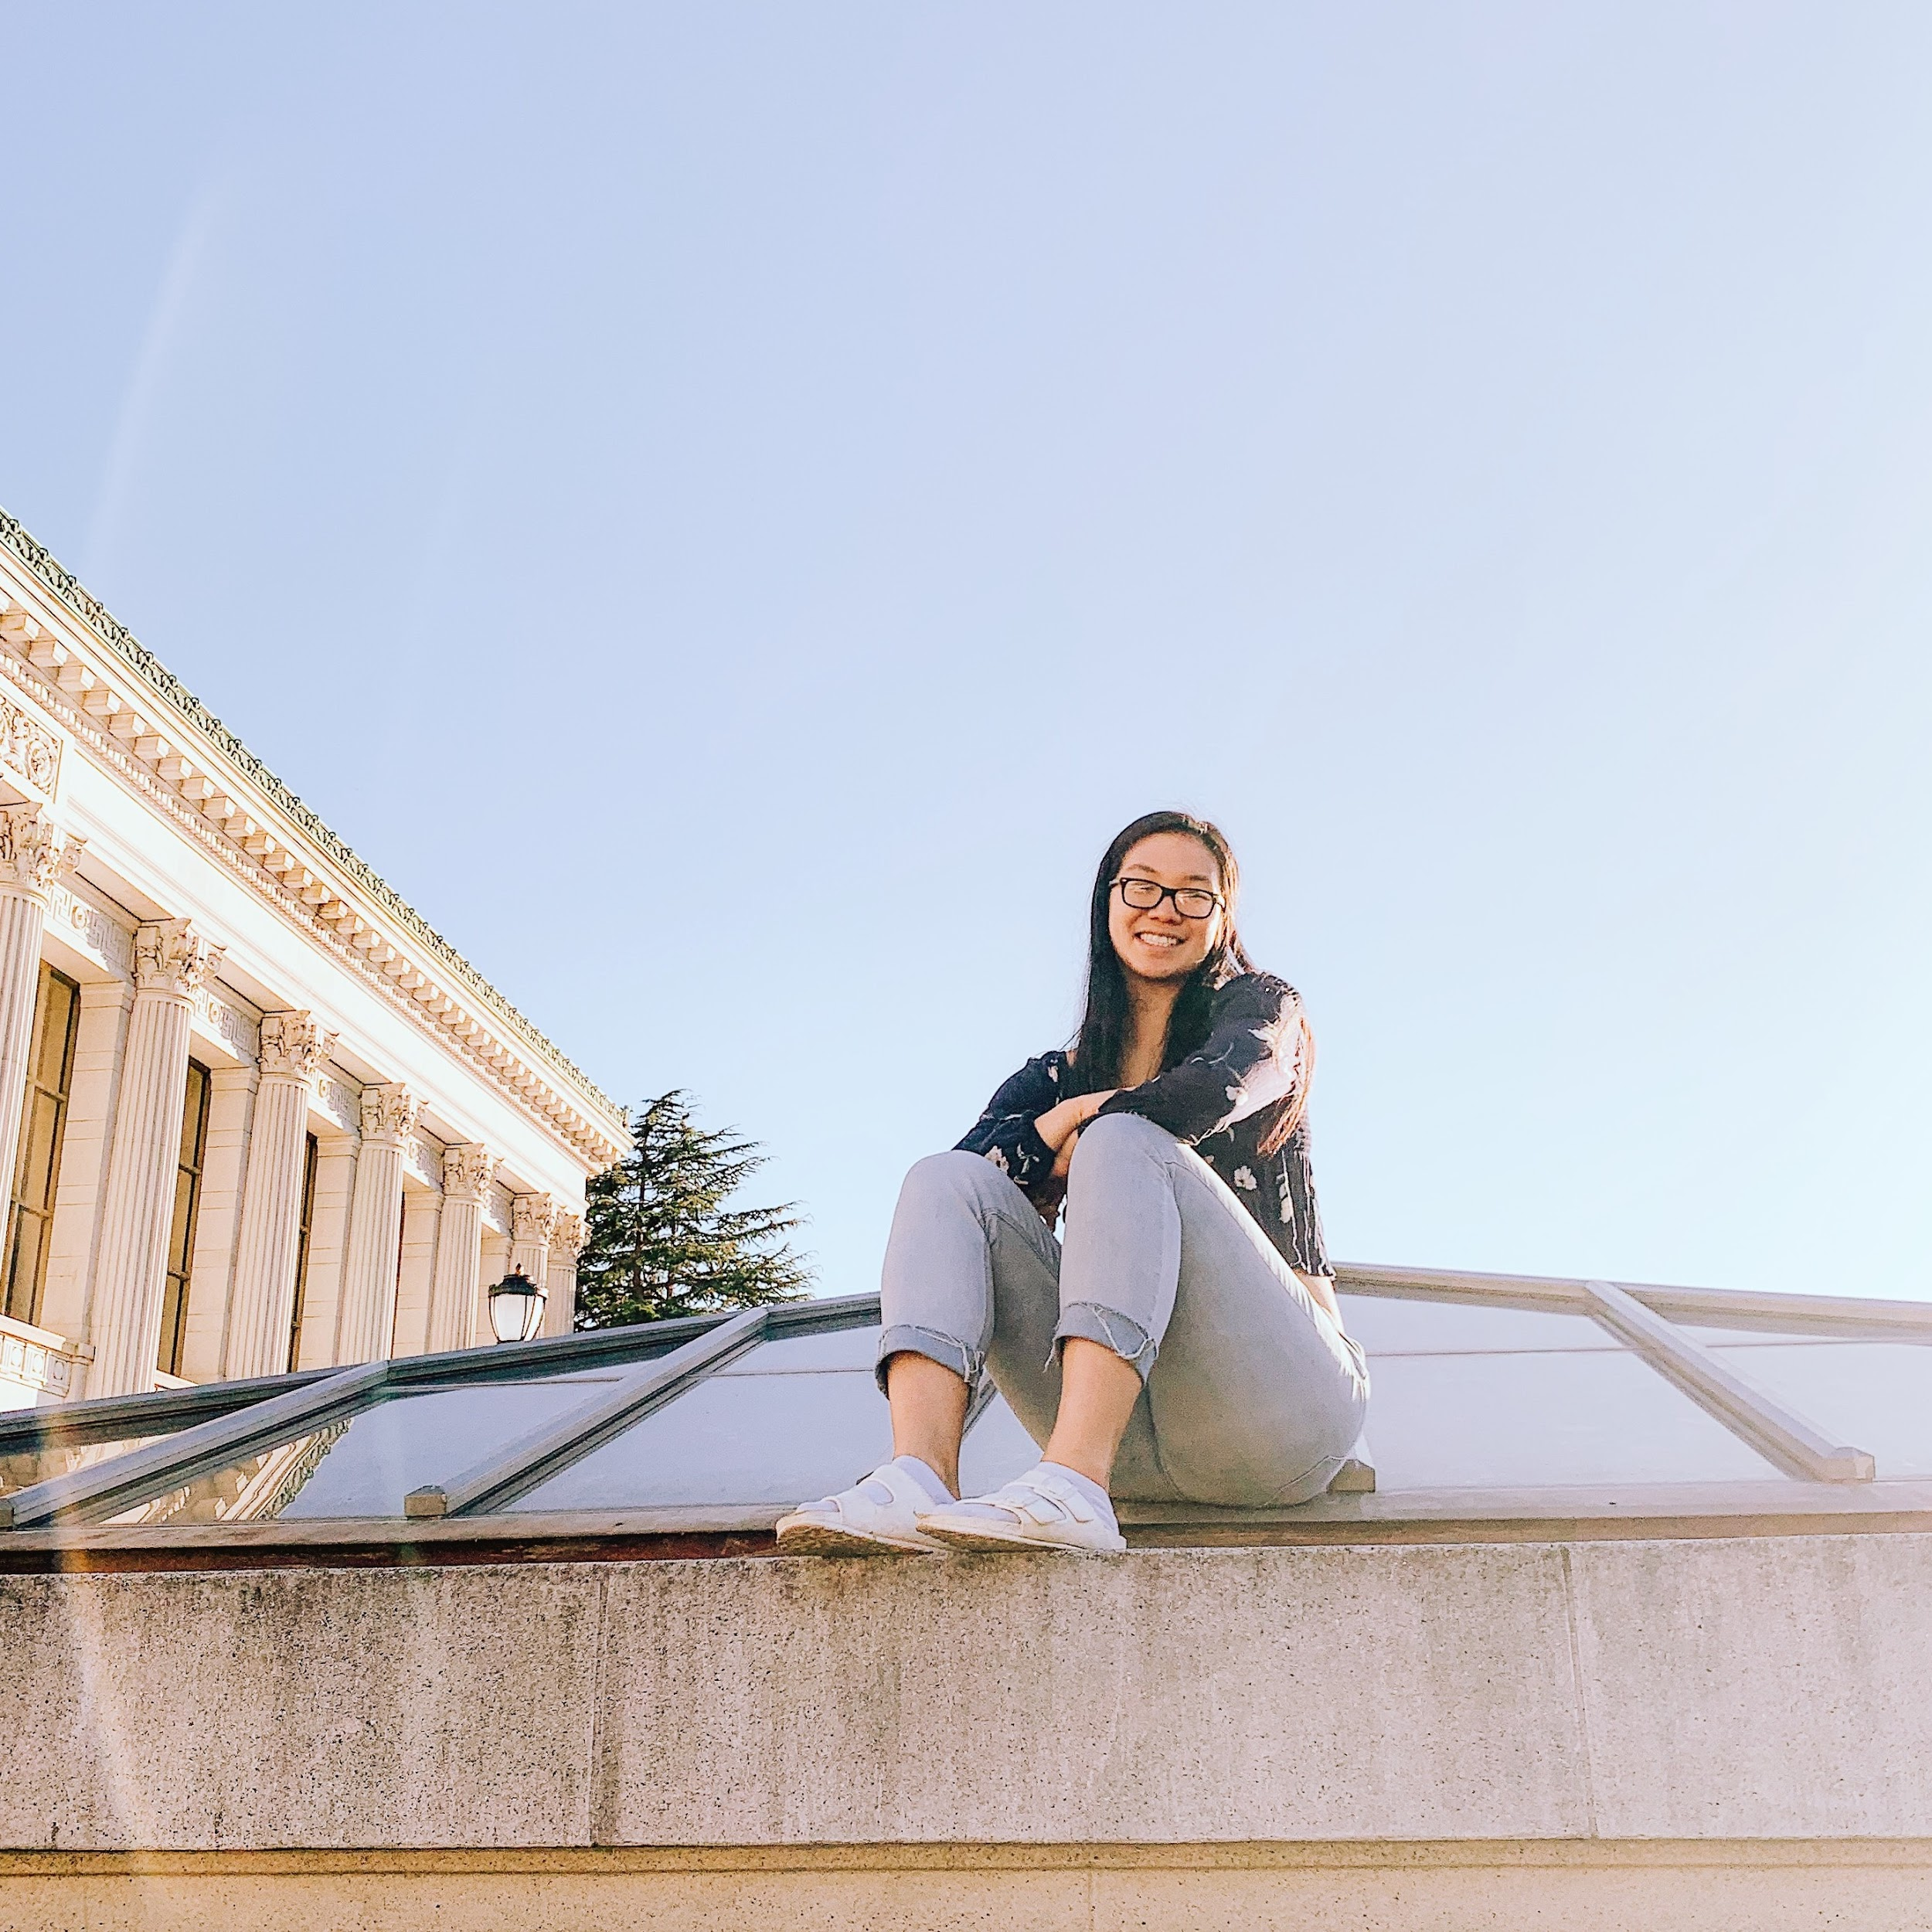

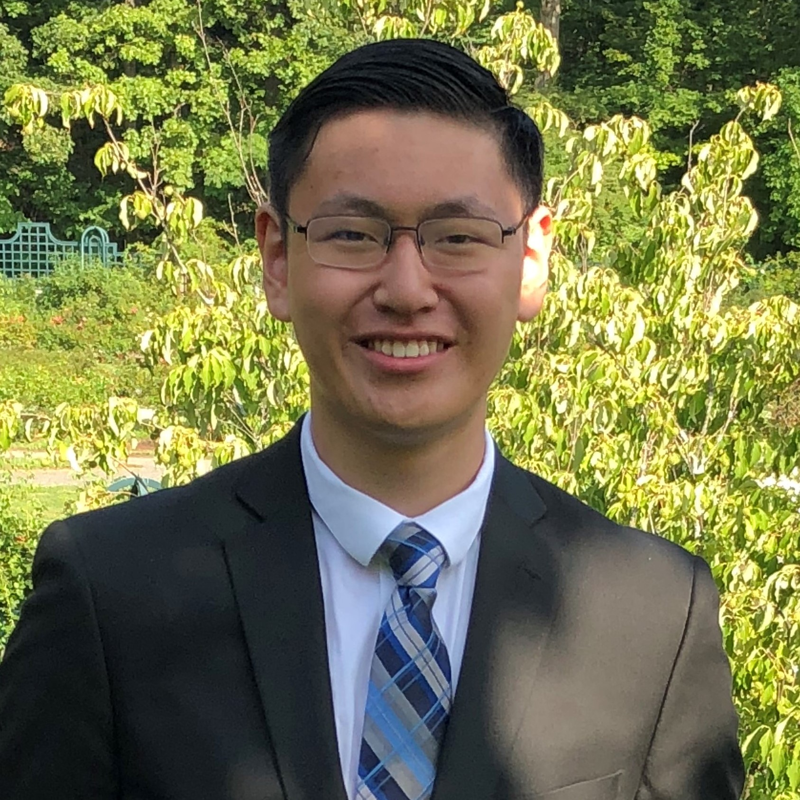
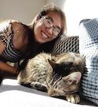
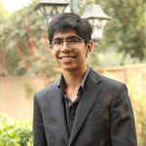
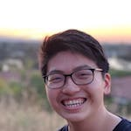
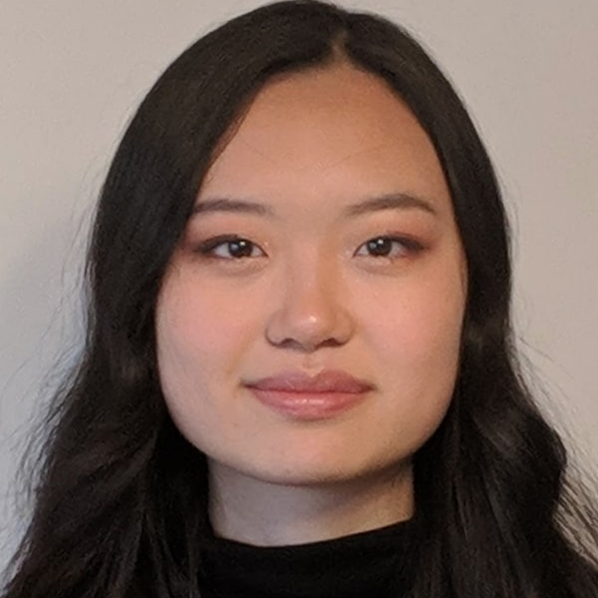
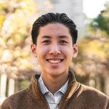


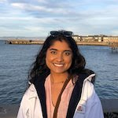

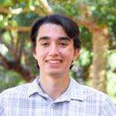
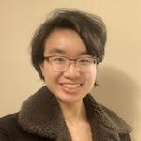

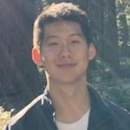
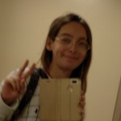
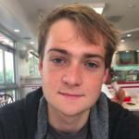
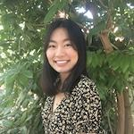
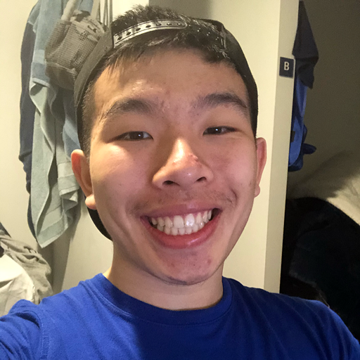
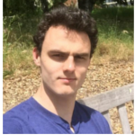
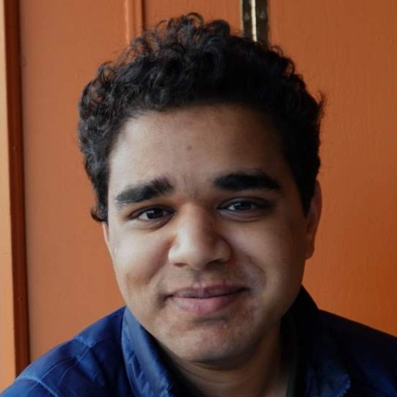
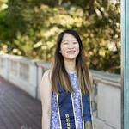
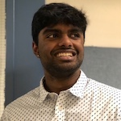
Thank you!

Slide 23
Q & A
Ask the staff anything (non-technical) you want!

